Slide 1


Universidade de Aveiro
Licenciatura em
Engenharia Informática
IHC
DATA: 15/04/2021
P6
Daniel Figueiredo, 98498
Eduardo Fernandes, 98512
João Borges, 98155

Slide 2
Why we choose Strava?

Slide 3
What is Strava?

Slide 4
Scale of severity and methods used
-A Streamlined cognitive walkthrough was used
-Scale of severity:
0 = I don't agree that this is a usability problem at all
1 = Cosmetic problem
2 = Minor usability problem
3 = Major usability problem
4 = Usability catastrophe

Slide 5
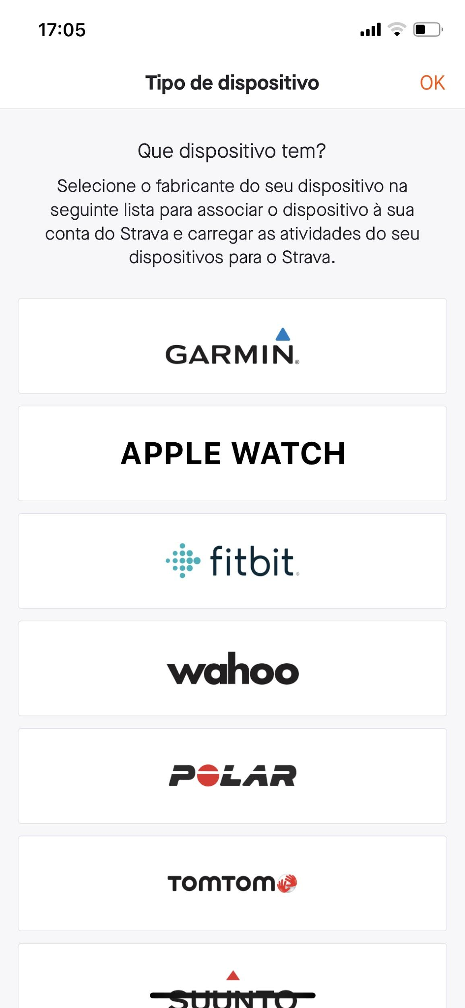
Heuristic Evaluation
Voltar
Issue: Name of button not very explicit
Heuristic: Match between system and the real world
Severity: Eduardo - 2
Daniel - 2
João - 1

Slide 6
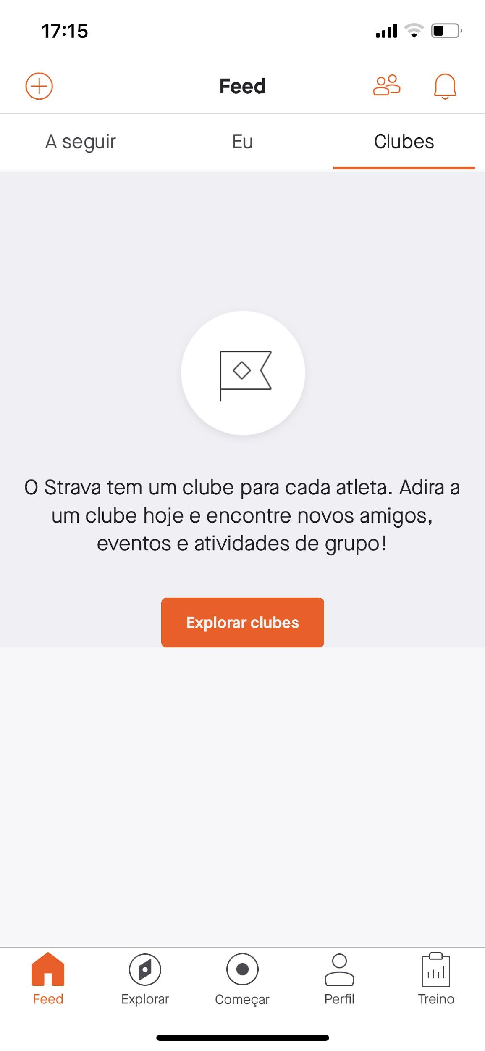
Heuristic Evaluation
Issue: Page name can’t probably be understood by everyone
Heuristic: Match between system and the real world
Severity: Eduardo - 2
Daniel - 2
João - 2

Slide 7


Heuristic Evaluation
Issue: The footer was different for the three of us even tho we were using the same language
Heuristic: Consistency and standards
Severity: Eduardo - 1
Daniel - 1
João - 1

Slide 8
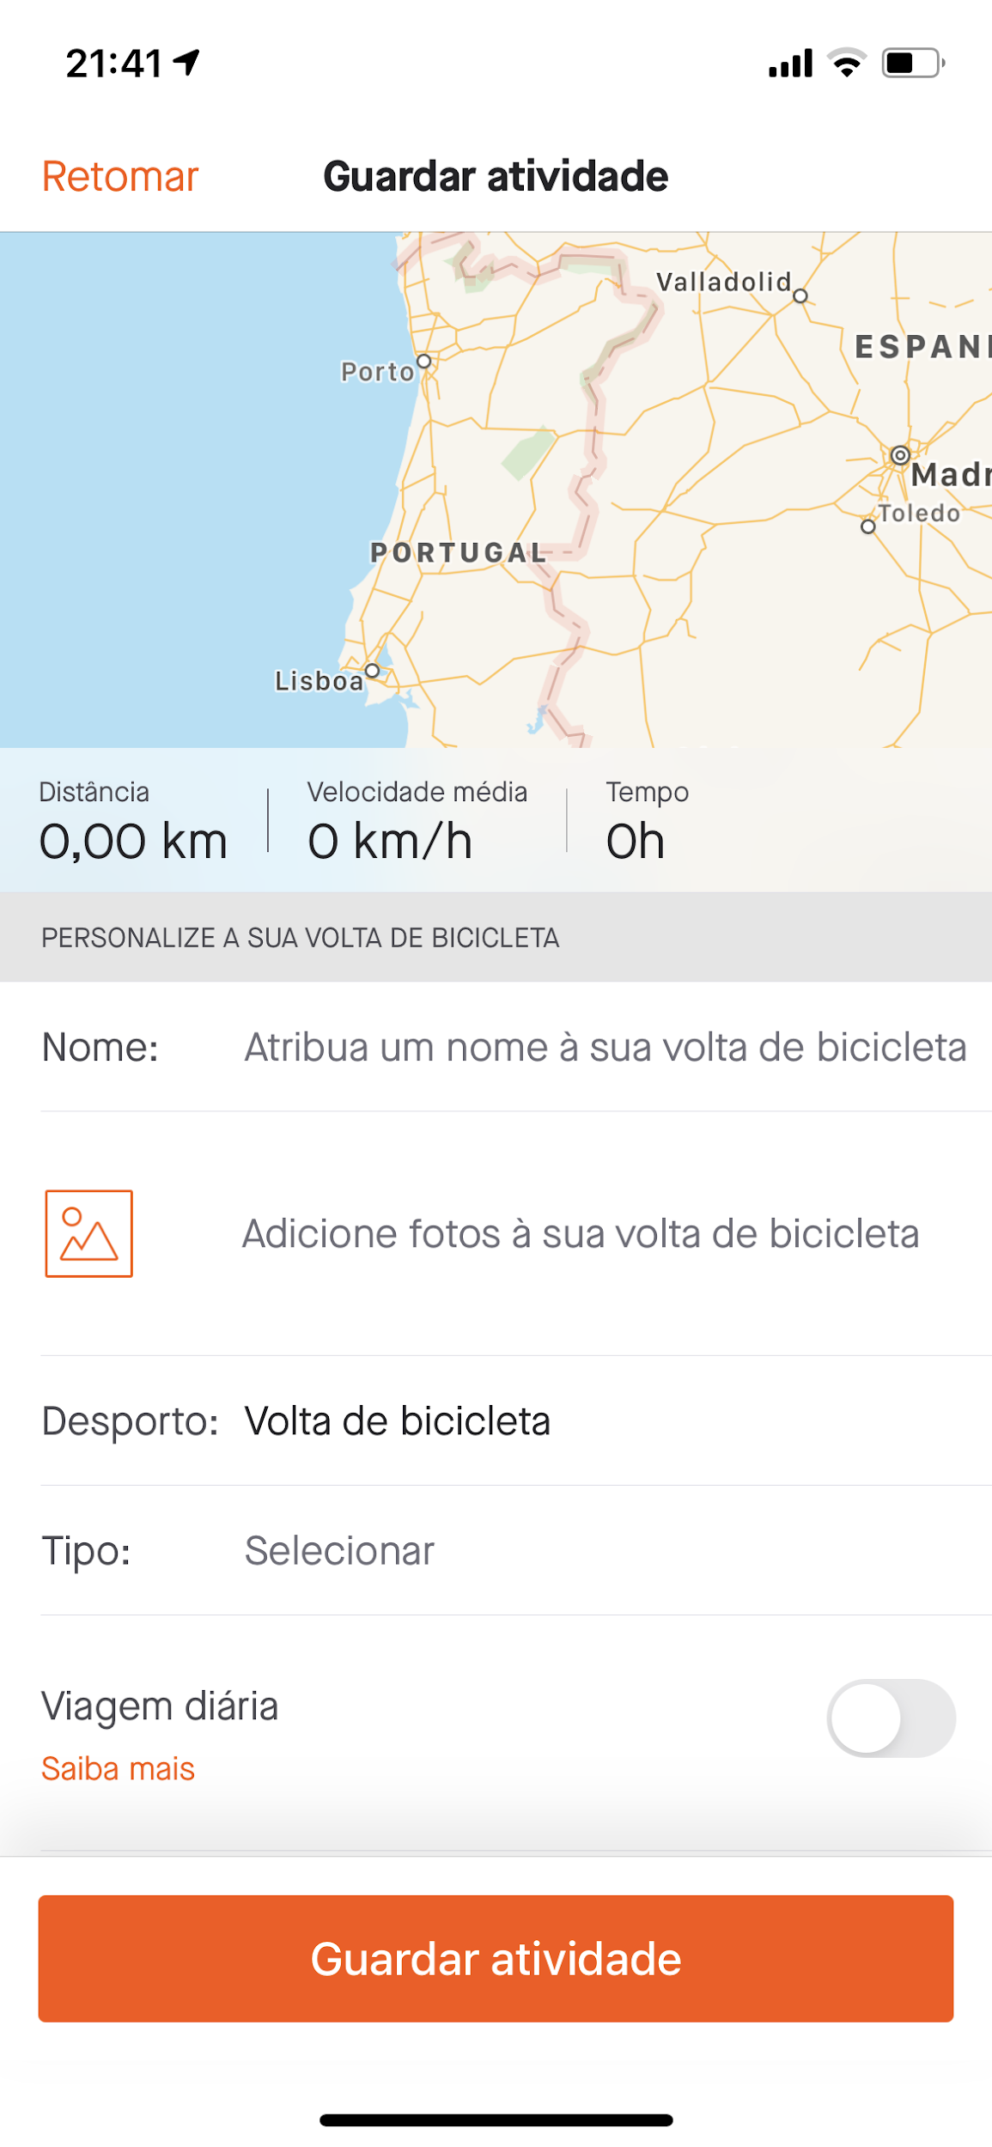
Heuristic Evaluation
Issue: A pop-up doesn’t appear to confirm if the user really want to add an activity
Heuristic: Error prevention
Severity: Eduardo - 3
Daniel - 3
João - 2

Slide 9
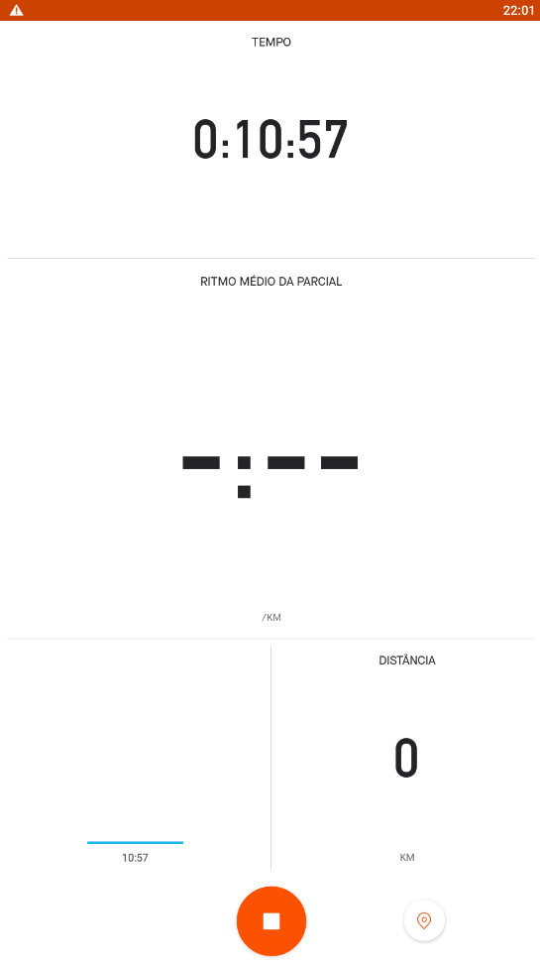
Heuristic Evaluation
Issue: There is no warning to the user when he is not registering any physical movement
Heuristic: Error Prevention
Severity: Eduardo - 3
Daniel - 3
João - 3

Slide 10
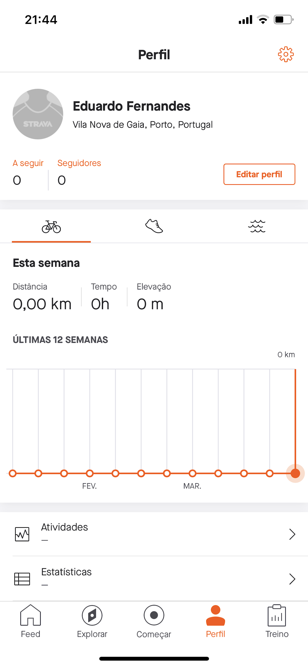
Heuristic Evaluation
Issue: Application settings only can be accessed in Profile tab
Heuristic: Flexibility and efficiency of use
Severity: Eduardo - 2
Daniel - 2
João - 1

Slide 11
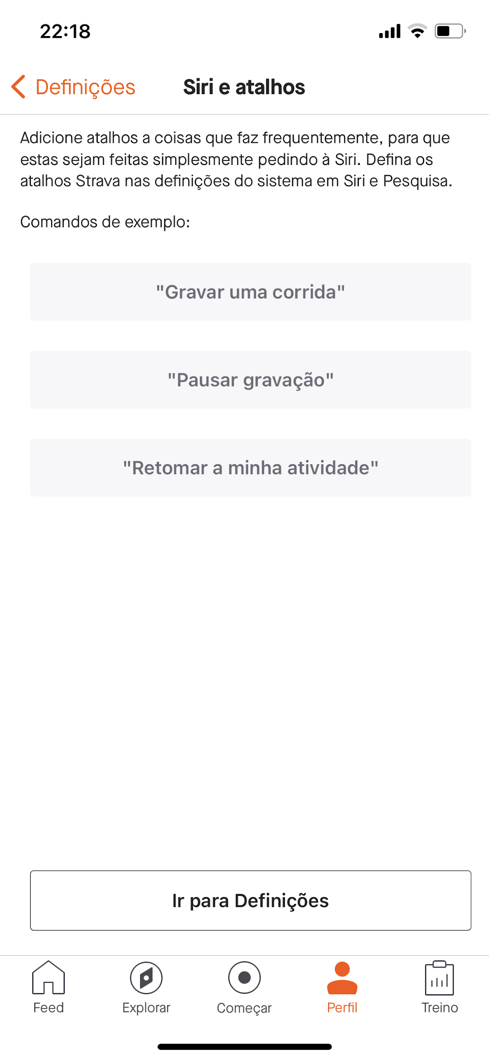
Heuristic Evaluation
Issue: There are no touch gestures shortcuts
Heuristic: Flexibility and efficiency of use
Severity: Eduardo - 2
Daniel - 2
João - 2

Slide 12
Heuristic Evaluation
Issue: No customization available for the user to personalize his interface
Heuristic: Flexibility and efficiency of use
Severity: Eduardo - 0
Daniel - 0
João - 1

Slide 13
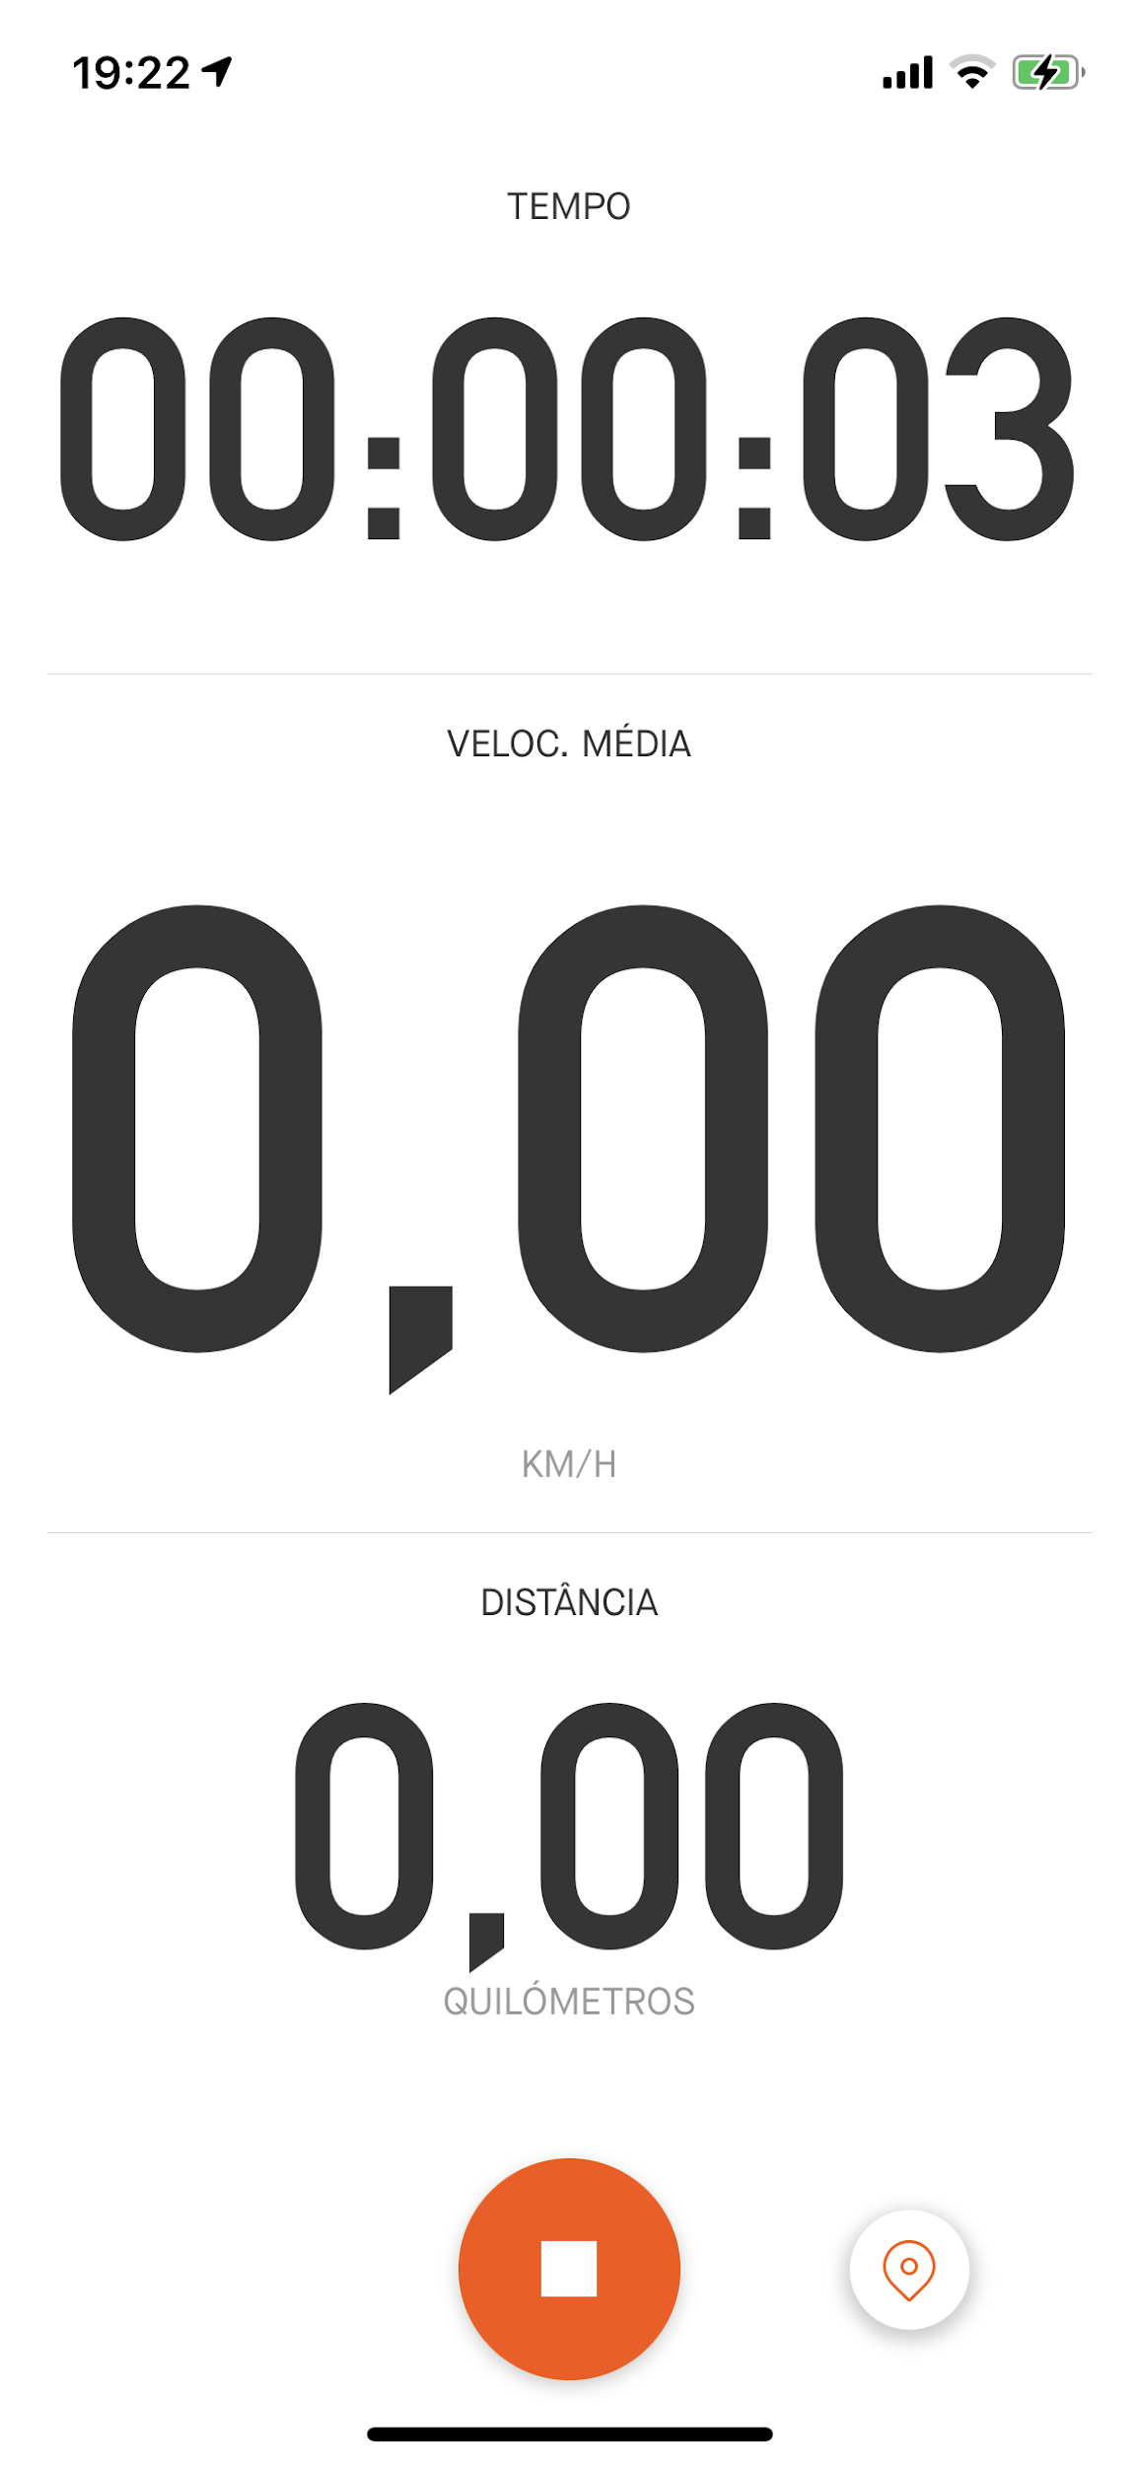


Cognitive Walkthrough
Task: Delete an activity during tracking
User: Any athlete that uses the application
Task analysis:
look for the icon (stop);
click on the icon ;
scroll down to the bottom of the page;
delete the current activity;
First action: look for the icon (stop)
Q1 - Will the user know what to do at this step?
Q2 - If the user does the right thing, will they know that they did the right thing, and are making progress towards their goal?

Slide 14
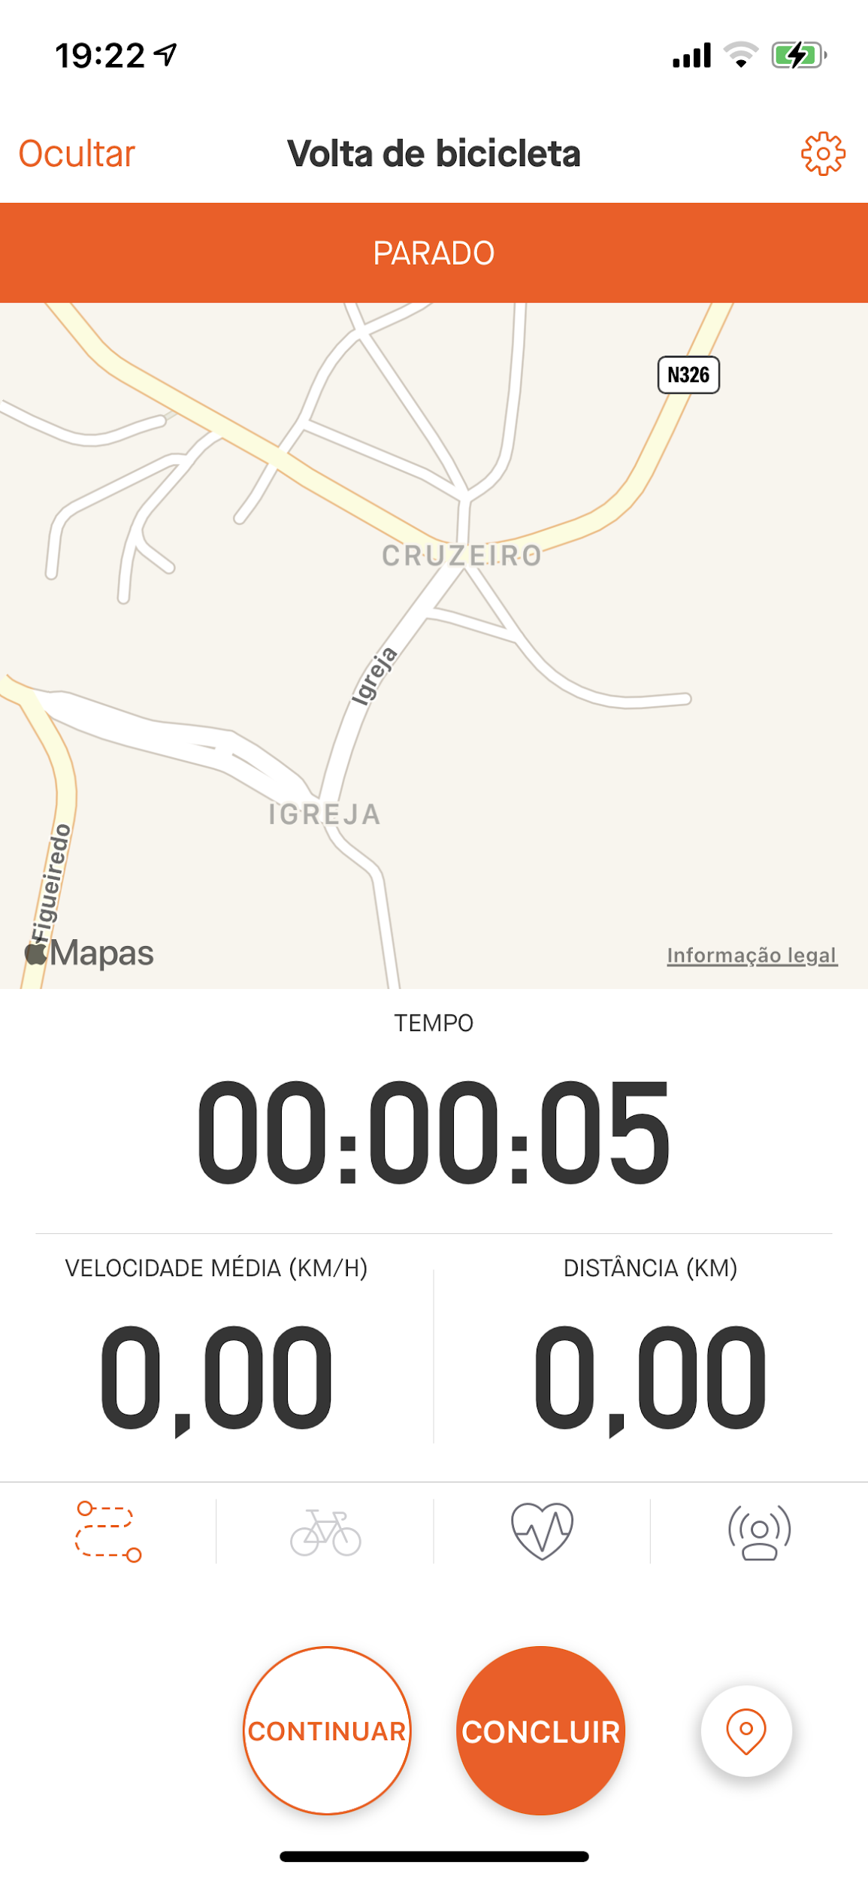
Cognitive Walkthrough
Second action: click on the icon
Q1 - Will the user know what to do at this step?
Q2 - If the user does the right thing, will they know that they did the right thing, and are making progress towards their goal?

Slide 15
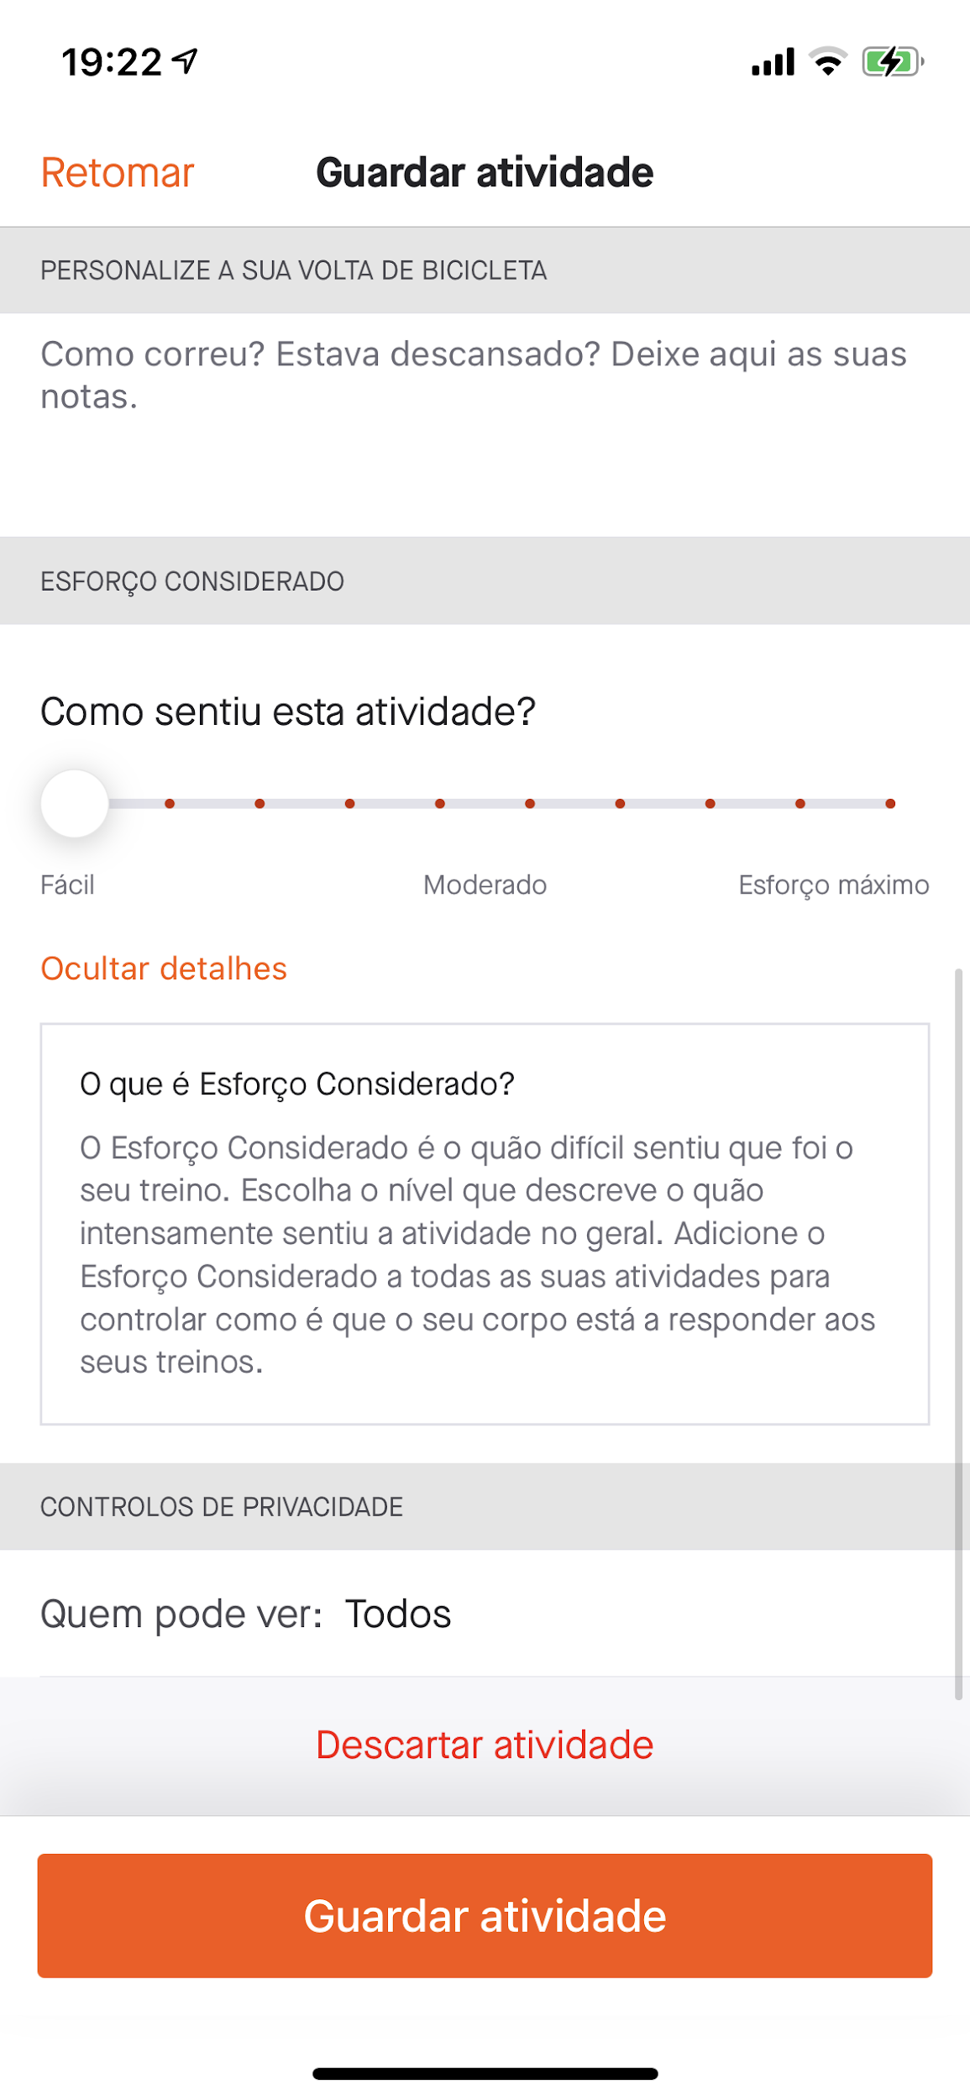
Cognitive Walkthrough
Third and fourth action: scroll down and delete the activity
Q1 - Will the user know what to do at this step?
Q2 - If the user does the right thing, will they know that they did the right thing, and are making progress towards their goal?

Slide 16
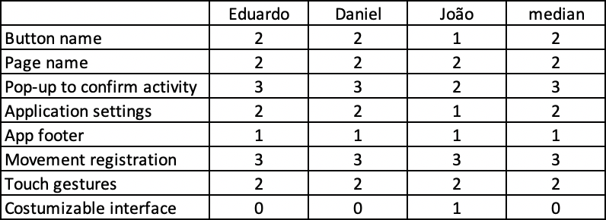
Results of the Heuristic Evaluation

Slide 17
Conclusion

